Slide 1

A Project Presentation On VISUALISATION AND STOCK PRICE PREDICTION Department of Computer Science & Engineering Galgotias College of Engineering & Technology, Greater Noida Dr. A.P.J. Abdul Kalam Technical University, Lucknow, Uttar Pradesh
Presented By
Amisha Baghel (1809710014)
Ayushi Jaiswal (1809710033)
Riya Parashar (1900970109008)
Guided By
Dr. Jaya Sinha
Associate Professor

Slide 2

Introduction
Share Market is an untidy place for predicting since there are no significant rules to estimate or predict the price of a share in the share market.
The common trend towards the stock market among the society is that it is highly risky for investment or not suitable for trade so most of the people are not even interested.
Many methods like technical analysis, fundamental analysis, statistical analysis, etc. are all used to attempt to predict the price in the share market but none of these methods is proved as a consistently acceptable prediction tool. In this paper, we will attempt to implement, forecast, analyze and visualize stock market prices.

Slide 3
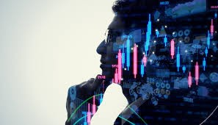
Despite the high prevalence of existing stock prediction approaches, there are several challenges that we need to consider when designing a practical end-to-end stock prediction framework to tackle the dynamic nature of the stock market.
The stock market is very unpredictable, any geopolitical change can impact the share trend of stocks in the share market, recently we have seen how covid-19 has impacted the stock prices, which is why on financial data doing a reliable trend analysis is very difficult. The most efficient way to solve this kind of issue is with the help of Machine learning and Deep learning.

Slide 4
Background
Literature survey
Traditional approaches to stock market analysis and stock price prediction include fundamental analysis, which looks at a stock's past performance and the general credibility of the company itself, and statistical analysis, which is solely concerned with number crunching and identifying patterns in stock price variation. Then predictions were achieved with the help of Genetic Algorithms (GA) or Artificial Neural Networks (ANN's), but these fail to capture correlation between stock prices in the form of long-term temporal dependencies.
Multiple techniques have always from the beginning been proposed to analyze the various phenomena in financial markets. The overarching goal of this research was to implement a computational model that derives the relationship between contextual information and related stocks in the financial market. We can divide the traditional models into two main approaches based on the type of information they are focused on: technical data or fundamental data.

Slide 5
problem statement
Market decision-making is difficult due to the stock market’s complex behavior and unstable nature. Accurate prediction is even more challenging considering the need to forecast the local stock market in different countries.
The other approach makes use of Neural Networks, which have Slow Convergence Rate, and takes a lot of time to train. and are based on gradient descent method which use gradient descent which is again an disadvantage while we propose to use time series analysis by training model from previous values by finding patterns in the dataset.
In this paper, a study is conducted on the effectiveness of Autoregressive Integrated Moving Average (ARIMA), on stocks from different sectors. We have chosen ARIMA model also because of its simplicity and wide acceptability of the model. We also have studied the effect on prediction accuracy based on various possible previous period data taken. The contribution of the paper , are a) Implementation using Arima model b) Analysis of prediction accuracy based on the varying span of previous period data.
While ARIMAs show increasingly promising results for forecasting Financial Time Series (FTS), this paper seeks to assess if further mechanisms and improvisation can further elevate performance.

Slide 6
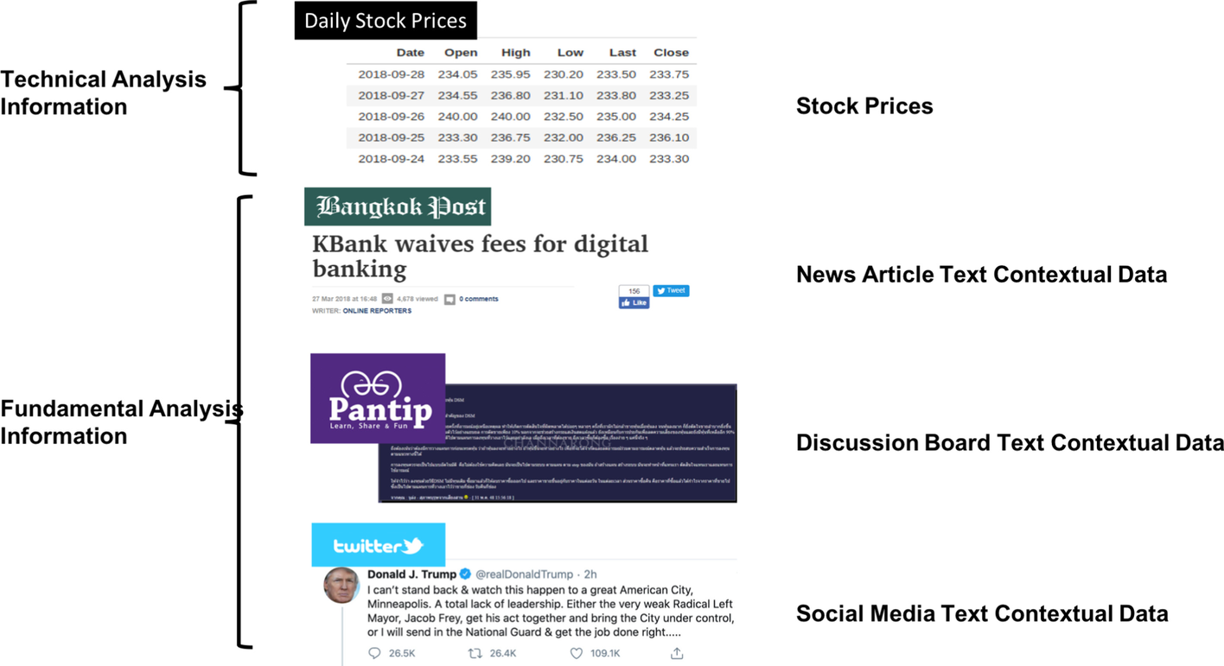
Proposed work
We aspire to reduce risks in stock market investment by developing an better prediction tool for stock prices.
The objective is to-
Select the best training mdoel for stock prices
2. Implement the Stock price prediction and visualization
3. Evaluate the performance of the system.

Slide 7
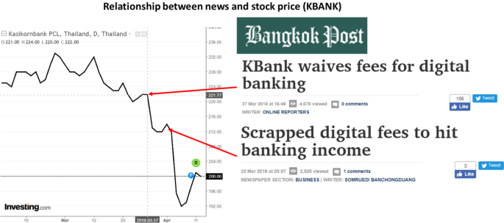
2.Heterogeneous behaviors need to be encoded for investors to understand stock trends:
Since financial information available on the Internet comes in a wide variety of types, sources, temporal dimensions, and thematic scales, it would be unfeasible to assemble all the information available. According to reports from Bomfim, there is strong evidence that news articles, social media contents, and general discussion contents are often important indicators of market movements. Moreover, they are critical for investors to keep abreast of the collective expectation and various reports or predictions on stock prices. Before the price suddenly dropped on March 27, 2018, there is a news announcement. Similarly, when the news headline “Scrapped digital fees to hit banking income” was released, an increase in the stock price was observed on the following date. Therefore, we should include these contextual data in the system.

Slide 8
System design
The guidelines encoded by rule-based systems often derive from experimental findings and expert experience. Therefore, an indirect manner, heuristics distill best practices learned from another analyst's experience of creating and consuming visualizations.
ARIMA: model is derived by general modification of an autoregressive moving average (ARMA) model. This model type is classified as ARIMA(p,d,q), where p denotes the autoregressive parts of the data set, d refers to integrated parts of the data set and q denotes moving average parts of the data set and p,d,q is all nonnegative integers.
ARIMA models are generally used to analyze time series data for better understanding and forecasting.

Slide 9
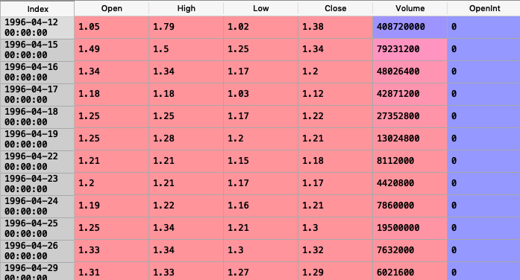
implementation
The dataset consists of stock market data of Altaba Inc. The data shows the stock price of Altaba Inc from 1996–04–12 till 2017–11–10. The goal is to train an ARIMA model with optimal parameters that will forecast the closing price of the stocks on the test data.
Dataset:

Slide 10
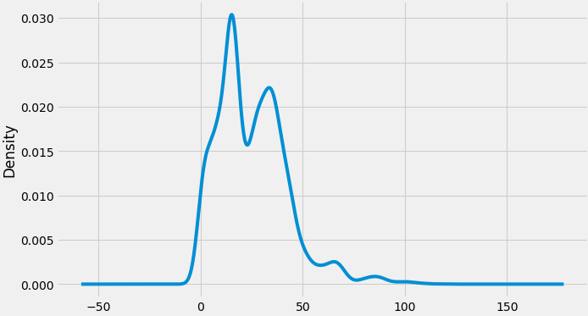
Also, a given time series is thought to consist of three systematic components including level, trend, seasonality, and one non-systematic component called noise.
These components are defined as follows:
Level: The average value in the series.
Trend: The increasing or decreasing value in the series.
Seasonality: The repeating short-term cycle in the series.
Noise: The random variation in the series.

Slide 11
Conclusion
Limitation
Each narrow application needs to be specially trained
Require large amounts of hand-crafted, structured training data
Learning must generally be supervised: Training data must be tagged
Require lengthy offline/ batch training
Do not learn incrementally or interactively, in real time
Poor transfer learning ability, re-usability of modules, and integration
Systems are opaque, making them very hard to debug
Performance cannot be audited or guaranteed at the ‘long tail’
They encode correlation, not causation or ontological relationships
Do not encode entities, or spatial relationships between entities
Only handle very narrow aspects of natural language
Not well suited for high-level, symbolic reasoning or planning

Slide 12
refrences
[1] Dzmitry Bahdanau, Kyunghyun Cho, and Yoshua Bengio. Neural machine translation by jointly learning to align and translate. arXiv preprint arXiv:1409.0473, 2014.
[2] Wei Bao, Jun Yue, and Yulei Rao. A deep learning framework for financial time series using stacked autoencoders and long-short term memory. PloS one, 12(7):e0180944, 2017.
[3] Christoph Bergmeir and José M Benítez. On the use of cross-validation for time series predictor evaluation. Information Sciences, 191:192–213, 2012.
[4] Tim Bollerslev. Generalized autoregressive conditional heteroskedasticity. Journal of econometrics, 31(3):307–327, 1986.
[5] John Parker Burg. A new analysis technique for time series data. Paper presented at NATO Advanced Study Institute on Signal Processing, Enschede, Netherlands, 1968, 1968.
[6] Rohitash Chandra and Mengjie Zhang. Cooperative coevolution of elman recurrent neural networks for chaotic time series prediction. Neurocomputing, 86:116–123, 2012.
[7] Sheng Chen and Steve A Billings. Representations of non-linear systems: the narmax model. International Journal of Control, 49(3):1013–1032, 1989.
[8] Robert F Engle. Autoregressive conditional heteroscedasticity with estimates of the variance of united kingdom inflation. Econometrica: Journal of the Econometric Society, pages 987–1007, 1982.
[9] Robert F Engle and Victor K Ng. Measuring and testing the impact of news on volatility. The journal of finance, 48(5):1749–1778, 1993.
[10] Orhan Firat, Kyunghyun Cho, and Yoshua Bengio. Multi-way, multilingual neural machine translation with a shared attention mechanism. arXiv preprint arXiv:1601.01073, 2016.

Slide 13
Future scope
Let us look at some of the top use cases evolving today, which will come to expand the future scope of machine learning.
1. Optimising Operations
The most common use case in optimising operations is in document management.
Sensors and IoT technologies are helping manufacturing operations optimise granularly across the supply chain.
The renewable energy industry is using AI to mitigate the unpredictability of sources.
2. Safer Healthcare
We’ve been seeing significant growth in machine learning being used to predict and support COVID-19 strategies.
Robots performing complicated surgeries precisely.
ML programs reading patient history, records, reports etc. to devise personalised treatment plans. IBM Watson Oncology is an important project in this space.
3. Fraud Prevention
Banks and other financial institutions use machine-learning based fraud detection technology to stop malpractices (although the irony of proving ‘I am not a robot’ to a machine is not lost!).
Banks are building machine learning algorithms based on historical data to predict fraudulent transactions.
Classification and regression methods are being used to identify and filter out phishing emails.
4. Mass Personalisation
Retail, social media and entertainment platforms use ML to give customers personalised services and experiences.
The face swap filter uses algorithms based on image recognition and computer vision to detect and (well, almost) accurately exchange facial features.

Slide 14
Thank you

Slide 15
Extracting design choices from a dual-axis scatterpot visualizing three columns of the MPG dataset.

Slide 17
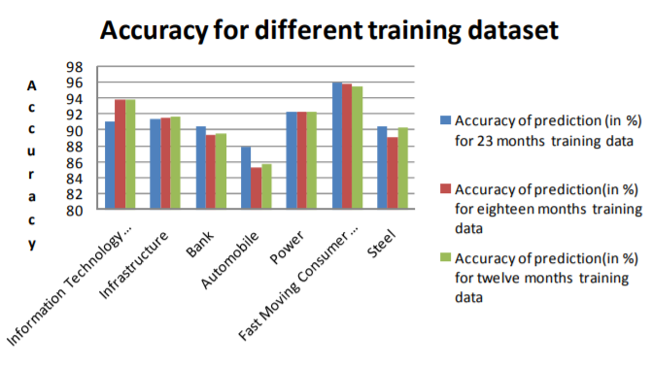
results
The high price of stocks is taken into consideration for implementation. All the implementation works are done through R [20]. All the series are stationary. The accuracy of prediction for different sectors are computed by averaging the accuracies obtained by the algorithm of top eight companies in that sector. The result is given below in Table 3

Slide 19
In terms of data quantity, the VizML training corpus is orders of magnitude larger than that of DeepEye and Data2Vis. The size of our corpus permits the use of 1) large feature sets that capture many aspects of a dataset and 2) high-capacity models such as deep neural networks.
The third major difference is one of data quality. In contrast to the few datasets used to train the three existing systems, the datasets used to train VizML models are extremely diverse in shape, structure, and distribution. Furthermore, the visualizations used by other ML-based recommender systems are generated by rule-based systems and evaluated under controlled settings. The corpus used by VizML is the result of real visual analysis by analysts on their own datasets.
However, VizML faces two major limitations. First, these three ML-based systems recommend both data queries and visual encodings, while VizML only recommends the latter. Second, in this paper, we do not create an application that employs our visualization model. Design considerations for user-facing systems that productively and properly employ ML-based visualization recommendation are important, but beyond the scope of this paper.
Each visualization in Plotly consists of traces that associate collections of data with visual elements. Therefore, we extract an analyst's design choices by parsing these

Slide 20
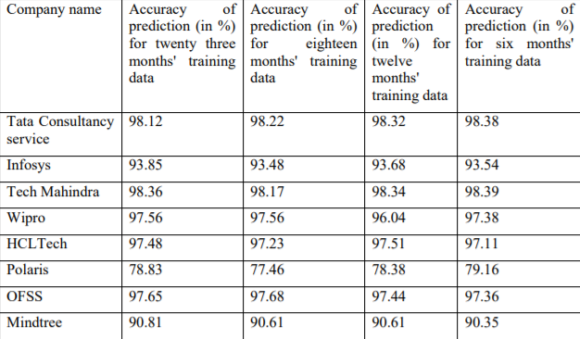
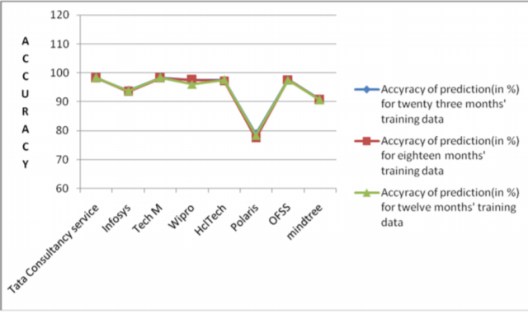

Slide 21
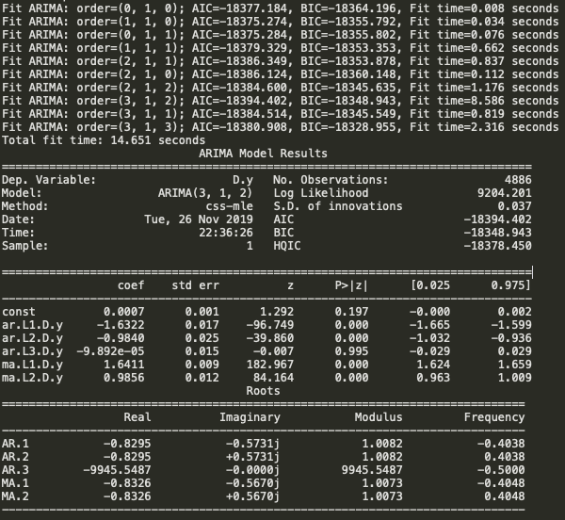
Auto ARIMA: Automatically discover the optimal order for an ARIMA model. The auto_arima function seeks to identify the most optimal parameters for an ARIMA model, and returns a fitted ARIMA model. This function is based on the commonly-used R function, forecast::auto.arima. The auro_arima function works by conducting differencing tests (i.e., Kwiatkowski–Phillips–Schmidt–Shin, Augmented Dickey-Fuller or Phillips–Perron) to determine the order of differencing, d, and then fitting models within ranges of defined start_p, max_p, start_q, max_q ranges. If the seasonal optional is enabled, auto_arima also seeks to identify the optimal P and Q hyper- parameters after conducting the Canova-Hansen to determine the optimal order of seasonal differencing, D.

